Slide 1
How to Do Research: A Step-By-Step Guide

Slide 2

Step 1. Develop a topic
| Select a Topic
| Develop Research Questions
| Identify Keywords
| Find Background Information
| Refine a Topic
Choose a topic that interests you and will hold your
attention. If you do, the research will be more enjoyable!

Slide 3



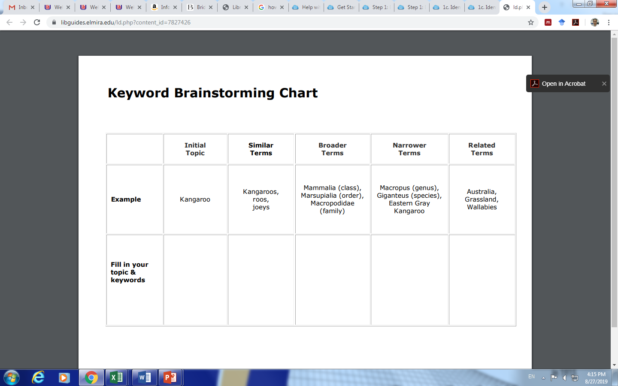
Select a Topic
Develop Research Questions
5 W’s questions
Write down what you already know or don't know about the topic.
Use that information to develop questions.
  Use probing questions. (why? what if?)
  Avoid "yes" and "no" questions.
Identify Keywords
textbooks
dictionaries
general encyclopedias
subject-specific encyclopedias
article databases
Credo Reference
Tracking Keywords
Make a list or use the chart below to track keywords related to your topic.

Slide 4
Refine a Topic
If you are finding too much information, your research topic may be too B ROAD. Consider narrowing it to a more specific:
Time | Civil War, Iron Age, 1920’s, 18th Century
Location | Europe, US, NY state, urban, eastern
Population | Age, race, gender, nationality, ethnic group, occupation
Event or Aspect | Government regulations related to ….
Person or Group | college students, Democrats, Republicans

Slide 5

Step 2. Locate information
| Books
| eBooks
| Specific Article
| Articles &Databases
| Videos & Images
|Journals & magazines
| Websites

Slide 6
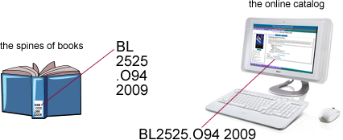
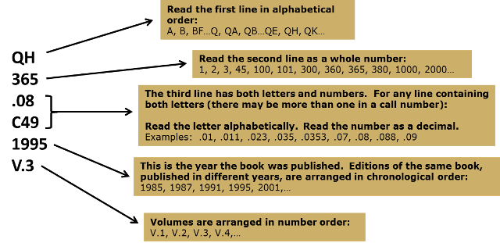
Search Strategies
Finding Books
Boolean Operators
Items are arranged on the shelves from left to right, top to bottom, according to call numbers. Call numbers are read in this format:
Operator | Examples | Results
AND | business AND ethics | Results contain ALL of the search terms.
OR | hotels OR motels | Results contain ANY of the search terms, but not necessary all of them
NOT | java NOT coffee Clinton NOT Bill | Excludes results containing the second search term

Slide 7
Where to Find Articles
Library Search: Search all databases in a single search. Click on the "Articles" icon for articles-only results.
Databases by Title: Find the database you need, or use the descriptions to select an appropriate one.
Databases by Subject: Search from the recommended databases listed in the box at the left-hand side of the screen.
Article Linking: If the database lists the article title, but does not provide the full text, click on the linking button to find the article in another database.
Browse Journal Titles: Type in the title, or part of the title of a journal to view a list of WU Library resources that include the journals and magazines.
Google Scholar: Search for academic articles. Available articles will be linked to Webster University Library resources.
Interlibrary Loan: If the WU Library does not have access to the article.

Slide 8
Step 3. Evaluate and analyze information
| Evaluate Sources
| Primary vs Secondary
| Types of Periodicals
https://libguides.elmira.edu/research

Slide 9




Evaluating Resources Using the CRAAP Method
CRITERIA | Questions to Ask
urrency | When was the source written and published? Has the information been updated recently? Is currency pertinent to your research?
elevance | Does the source cover your research topic comprehensively or only cover one aspect? To what extent does the source answer your research question? Is the source considered popular or scholarly? Is the terminology and language used easy to understand? Does the source meet the requirements of your research assignment?
uthority | Who is the author (person, company, or organization)? Does the source provide any information that leads you to believe the author is credible or an expert on the topic? Can you describe the author's background (experience, education, knowledge)? Does the author provide citations? Do you think they are reputable?
ccuracy | Can facts or statistics be verified through another source? Based on your knowledge, does the information seem accurate? Does it match the information found in other sources? Are there spelling or grammatical errors?
urpose | What is the purpose or motive for the source (educational, commercial, entertainment, promotional, etc.)? Who is the intended audience? Is the author pretending to be objective, but really trying to persuade, promote or sell something? Does the source seem biased?

Slide 10
Primary vs Secondary
Source Type | Examples
Primary A first-person account by someone who experienced or witnessed an event. The original document has not been previously published or interpreted by anyone else. | First-person account of an event First publication of a scientific study Speech or lecture Original artwork Handwritten manuscript Letters between two people A diary Historical documents, e.g. Bill of Rights
Secondary One step removed from the primary original source. The author is reexamining, interpreting and forming conclusions based on the information conveyed in the primary source. | Newspaper reporting on a scientific study Review of a music CD or art show Biography
Tertiary Further removed from a primary source. It leads the researcher to a secondary source, rather than to the primary source. | Bibliography Index to articles Library catalog

Slide 11

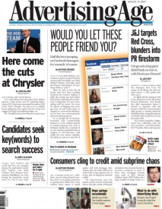



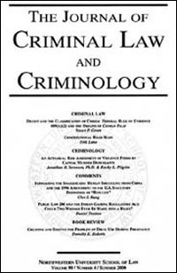





Types of Periodicals
Trade Magazines
Academic Journals
General Interest Magazines
Newspapers

Slide 12
Scholarly Article
Authorship
Publisher
Content/ Length
Sources Cited
Structure
Audience

Slide 13
Step 4. Write, organize, and communicate information
| Take Notes
| Outline the Paper

Slide 14
3 Forms of Notetaking
Summarize: Capture the main ideas of the source succinctly by restating them in your own words.
Paraphrase: Restate the author's ideas in your own words.
Quote: Copy the quotation exactly as it appears in the original source. Put quotation marks around the text and note the name of the person you are quoting.

Slide 15
Tips for taking notes electronically
Try using a bibliographic citation management tool to keep track of your sources and to take notes.
Use the following tips when creating a master document for your notes, sources, and ideas.
  As you add sources, put them in the format you're using (MLA, APA, Chicago, etc.).
  Group sources by publication type (i.e., book, article, website).
  Number each source within the publication type group.
  For websites, include the URL information and the date you accessed each site.
  Next to each idea, include the source number from the Works Cited file and the page number from the source. See the examples below. Note that #A5 and #B2 refer to article source 5 and book source 2 from the Works Cited file.
When done taking notes, assign keywords or sub-topic headings to each idea, quote or summary.
Use the copy and paste feature to group keywords or sub-topic ideas together.
Back up your master list and note files frequently!

Slide 16
Tips for taking notes by hand
Use index cards to keep notes and track sources used in your paper.
Create Work Cited cards for each source.
  Include the citation (i.e., author, title, publisher, date, page numbers, etc.) in the format you're using. It will be easier to organize the sources alphabetically when creating the Works Cited page.
  Number the source cards.
On each note card:
  Use only one side to record a single idea, fact or quote from one source. It will be easier to rearrange them later when it comes time to organize your paper.
  Include a heading or key words at the top of the card.
  Include the Work Cited source card number.
  Include the page number where you found the information.
Taking notes:
  Use abbreviations, acronyms, or incomplete sentences to record information to speed up the notetaking process.
  Write down only the information that answers your research questions.
  Use symbols, diagrams, charts or drawings to simplify and visualize ideas.

Slide 17
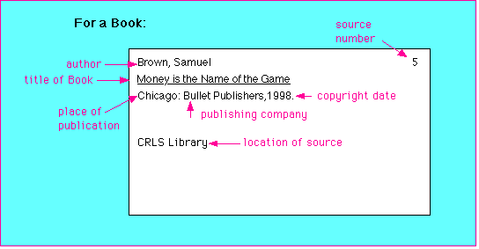
Example of a Work Cited Card

Slide 18
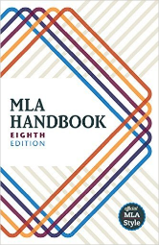

Step 5. Cite sources
| Avoid Plagiarism (see next slide)
| Zotero - Zotero is a free, easy-to-use citation management tool to help you
collect, organize, cite, and share your research sources.
EasyBib - is a cost-free, ad-free citation tool with thousands of citation styles
MLA
APA
Publication Manual of the American
Psychological Association
Annotated Bibliographies (see next slide)

Slide 19
Avoid Plagiarism
Plagiarism is a serious form of academic dishonesty, defined as "The action or practice of taking someone else's work, idea, etc., and passing it off as one's own; literary theft."
Understand what plagiarism is.
Paraphrase the original text into your own words.
Know the difference between quoting directly, paraphrasing, and summarizing.
Take clear notes, using quotation marks when copying someone else's words.
Know when to quote, e.g.: a direct quotation, a paraphrase of another author's argument, a summary of someone else's argument even if it's in your own words.
Use quotation marks around text that has been taken directly from the original source.
Note that changing someone else's words around or merely substituting synonyms for their words is still plagiarism.
Cite every source of information you use in your paper unless it is common knowledge or the results of your own research.
Remember to cite Internet sources, the minutes of meetings, speeches, films, TV shows and ads, and anything else that is someone else's work.
Plan ahead! Many people who plagiarize simply ran out of time when they were up against a deadline.

Slide 20
Parts of an Annotated Bibliography
An annotated bibliography is a list of citations followed by a descriptive summary and/or evaluation.
An annotation may include some or all of these parts:
a citation to the source
qualifications of the author(s)
purpose or scope of the work
topics covered
summary of findings or conclusions
audience or reading level
bias or standpoint of author(s)
relationship to works in the field
format/special features
relevance to your own research

Slide 21
Recommended Websites
Annotated BibliographiesPurdue's Online Writing Lab (OWL)
Annotated BibliographiesUniversity of Wisconsin-Madison
Writing an Annotated BibliographySkidmore College, Lucy Scribner Library
How to Prepare an Annotated BibliographyCornell University, Olin & Uris Libraries
How to Write an Annotated BibliographyUniversity Library, University of California Santa Cruz
Writing an Annotated BibliographyOwen Williams, University of Minnesota, Crookston Library
Source: https://libguides.elmira.edu/c.php?g=184944&p=1221045

Slide 22
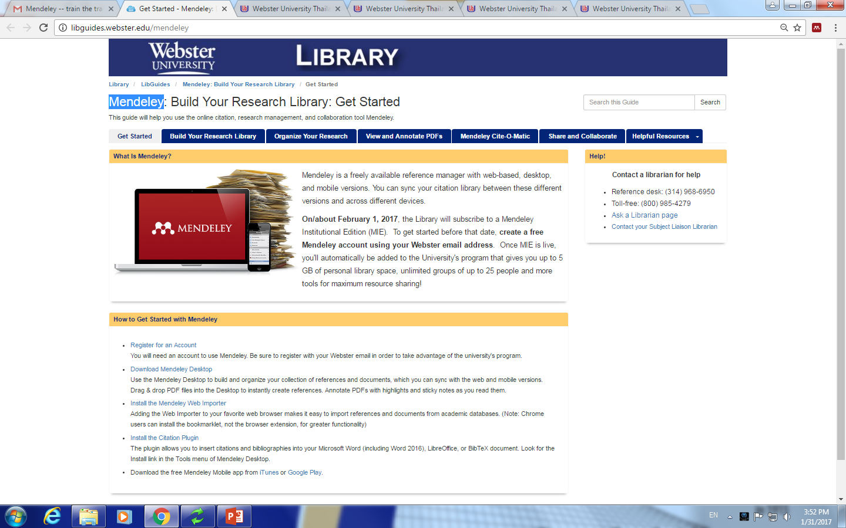
Links: https://www.mendeley.com/sign/out/ http://libguides.webster.edu/mendeley
MENDELEY – citation tools

